Slide 1

What’s New for Transition to
Special Education Services?
Paula E. Goff, Part C Coordinator
May 23, 2013

Slide 2

What is Early Intervention under Part C ?
Early intervention is a system of coordinated services and strategies that promotes the child's growth and development and supports families during the critical early years.

Slide 3
What guides services in Part C?
The Individualized Family Service Plan (IFSP) is the plan of services developed by a team that includes:
  Desired Outcomes for the child and family
  Early Intervention Services necessary to achieve the outcomes
  Other services not funded by First Steps but that are needed to achieve the outcomes

Slide 4
First Steps Participation:
Total with Active IFSPs
* Total to date

Slide 5
First Steps Participation:
Eligibility Process
 | Est. Risk | Screened | Referred for Evaluation | Evaluated | Eligible
FY11 | 406 | 5631 | 4223 | 4629 | 3708 | 80%
FY12 | 362 | 5760 | 4532 | 4894 | 3926 | 80%
FY13* | 355 | 5334 | 4185 | 4540 | 4211 | 93%

Slide 6
First Steps Core Concepts
    Natural Environments
    Family-Centered Services
    Primary Service Provider paired with
    a consultative model of service delivery
    Payor of Last Resort

Slide 7
Primary Service Provider (PSP)
Service delivery by one person with supporting services provided through joint visits & consultation.
PSP works in close collaboration with other team members integrating & synthesizing information shared to deliver efficient & comprehensive support.

Slide 8
Consultative Model
“…within the context of early intervention means service providers will focus primarily on family defined needs, and will share strategies with caregivers that allow the family to maximize natural learning opportunities or embed instruction into their daily routines and activities. The consultant (special instructor or therapist) provides services to the child through a parent or caregiver…”
(File & Kontos, 1992)

Slide 9
Differences between Part C & Part B
Part C | Part B
Early Intervention Services are based on child’s functioning and family priorities and concerns. | Special Education Services are part of a Free Appropriate Public Education (FAPE). Educational needs are the basis for special education.
Early Intervention Services address both family and child outcomes. Teaching parents the strategies to address their child’s needs is the primary focus of services. | Child is the focus of Special Education Services.
Parents have the right to accept only the services that they want without jeopardizing the provision of services. | Parents must give consent for the specially designed instruction. Related Services are provided to support the specially designed instruction.

Slide 10
Transition Data: Exiting at Age 3
422/12%
539/15%
304/9%
2218/64%
Total of 3483 Children Exited First Steps at or near age 3

Slide 11
IDEA Requirements: Part C
Policies to ensure an effective transition for toddlers receiving Early Intervention Services to preschool or other appropriate services.
A description of how First Steps will notify the State Education Agency (SEA) and the Local Education Agency (LEA) that the child will shortly reach the age of eligibility for preschool services under Part B.
A conference, with the approval of the parents with First Steps, the family, and the LEA at least ninety (90) days and up to six (6) months before the child is eligible for preschool services under Part B, to discuss any such services that the child may be eligible to receive.

Slide 12
Notification of SEA/LEA & Referral to LEA
First Steps sends a list of children who are 2 years old to KY Department of Education (KDE) quarterly. (Notification)
KDE sends a list of children who are two and potentially eligible for Part B services to the LEA. (Referral)

Slide 13
Parent OPT-Out
Parents have the right to request that their child’s personally identifiable information is not sent to the LEA—this is known as “Opt-Out”.
5% (N: 190) of families choose this option.
The LEA can only be told of a child whose parent opts-out with parent permission.

Slide 14
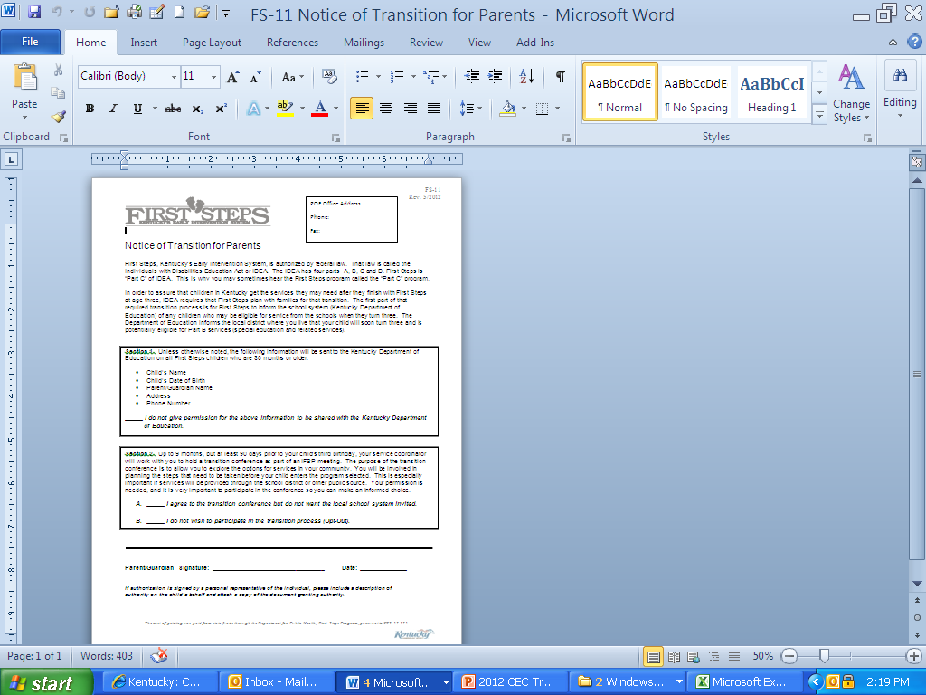
Notice of Transition for Parents FS-11

Slide 15
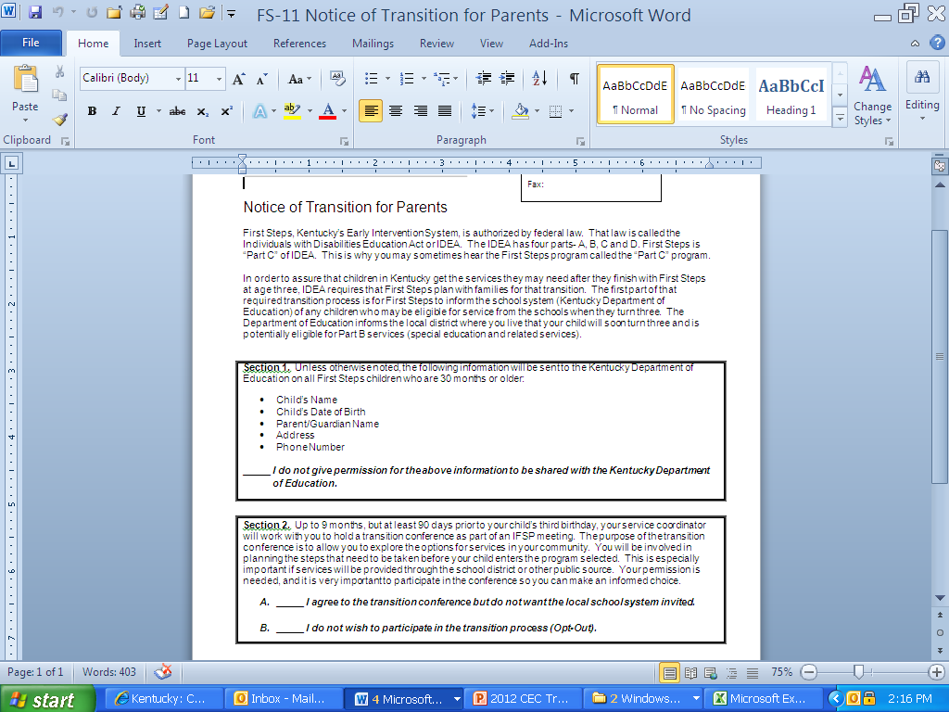
Section of FS-11 Notice of Transition

Slide 16
Transition Conference
Part C must convene a meeting with the LEA and family to discuss future services (with parent approval).
This must be held no later than 90 days prior to the third birthday and not more than 9 months before the third birthday.
Notes:
Convene a transition conference with the LEA and family to discuss any services the toddler will receive under Part B, not fewer than 90 days and not more than 9 months before a child’s third birthday and with approval from the family.
Discuss at the transition conference a review of program options for the time period of the child’s the third birthday through the remainder of the school year.
Provide parents at the conference with information about Part B preschool services including:
a description of the Part B eligibility definitions;
state timelines and process for consenting to an evaluation and conducting eligibility determinations under Part B; and
the availability of special education and related services.
With parental consent, provide the LEA with copies of the most recent IFSP, progress reports, and assessments for their review and use in eligibility determination for Part B services.
Develop a transition plan at the transition conference with the family that includes steps for the toddler with a disability to exit from the Part C program and any transition services that the IFSP team identifies as needed by that toddler and his or her family

Slide 17
Scheduling the Transition Conference
First Steps Policy & Procedure Manual:
“Service Coordinators should begin scheduling the Transition Conference early enough (at least one month before the desired meeting date) so that the LEA representative can be present.”

Slide 18
Discussion at Transition Conference
Part B preschool services including:
    a description of the Part B eligibility definitions;
    state timelines and process for consenting to an evaluation and conducting eligibility determinations under Part B; and
    the availability of special education and related services.
Program options for time period of 3rd birthday through remainder of school year

Slide 19
Requirements for Part C Documentation
The following transition steps must be included in the transition plan:
  confirmation that the child find information has been transmitted to the LEA (transition notification)
  with parent consent, confirmation that most recent evaluation, assessment, and IFSP has been sent to the LEA.

Slide 20
Transition Process from Part C View

Slide 21
Late Referrals to First Steps
Late referrals means children referred to First Steps at age 2 years, 10 and ½ months.
This is 45 days or less before age 3.
First Steps does not determine eligibility on these children.

Slide 22
Late Referrals to Part C
First Steps must refer child to LEA (parent consent is not required).
KDE is notified of the referral with parent consent.
LEA processes this type referral the same as any referral received for a child without an IFSP.

Slide 23
Part B Requirements for Transition according to OSEP
Upon notification of a child receiving Part C services may be potentially eligible for Part B services, the LEA must consider this to be an initial referral to Part B and therefore, the LEA is required to complete the following actions (Part B regulation §300.504(a)(1)):
  Send procedural safeguards to the child’s parents; and
  With parent approval, attend the transition conference which is initiated by KEIS

Slide 24
LEA Responsibilities: Part C Referrals
With parent consent,
Evaluate the child
Determine eligibility for Part B services (within 60 school days)
If eligible:
Develop an IEP (within 30 days of eligibility)

Slide 25
LEA Responsibilities: Part C Referrals
Invite the service coordinator or other Part C representative to the initial IEP meeting with approval of the family.
To consider the child’s IFSP including the early intervention services and natural environments statement when developing the IEP.

Slide 26
Children who were referred to Part C between the ages of 2 years, 9 months and 2 years, 10.5 months (NO IFSP)
District must:
  conduct an initial evaluation under Part B within 60 school days of receiving parental consent for the evaluation, even if that timeline expires after the child’s third birthday; and if eligible,
  hold a meeting to develop an IEP within 30 days of a determination that the child needs special education and related services.

Slide 27
Late Referrals to Part B (referrals to the LEA) less than 90 days before the 3rd birthday*
LEA is responsible for:
Ensuring that an initial evaluation under Part B is completed and if eligible,
An IEP is developed and implemented by the child’s third birthday, even if the timeline for conducting an initial evaluation expires after the child’s third birthday.
*NOTE: These are children who should have been referred to the LEA 90 days or more before the 3rd birthday.

Slide 28
Facilitating Transition
What information does First Steps have that is helpful to the District?
  IFSP
  Progress Reports
  Assessments
First Steps must have parent consent to share information

Slide 29
IFSP
The IFSP includes outcomes based on the family’s priorities and concerns, a transition plan, and service detail. Family priorities drive the services that are provided through First Steps.
Early Intervention Providers must enter service notes for each visit. These are available with parent consent but caution—
  Notes will not be analyzed; copies are a large Excel spreadsheet that the district will need to read for useful information.

Slide 30
Assessments
Initial Assessments
Children with a Developmental Delay—
  Norm-Referenced Instrument
  Criterion-Referenced Instrument
Children with an Established Risk Condition—
  Criterion-Referenced Instrument
Ongoing Assessments
Annual
Exit
Note: Some children may have discipline-specific assessments

Slide 31
Progress Reports
This report contains:
  Number of planned and delivered visits
  Evidence-based interventions used with child
  Summary of progress data
  Narrative summary of progress
This may be the best source of specific information regarding IFSP services for review by the LEA when determining RTI.

Slide 32
Questions?
Contact First Steps State Lead Agency
Email: Chfs.firststeps@ky.gov
Call: 877-317-8377

